Slide 1
RENATE 2011 - 2018
RELIGIOUS IN EUROPE NETWORKING AGAINST TRAFFICKING AND EXPLOITATION
7th of March 2018, Snagov, Romania
Sr. Adina Balan, CJ

Slide 2
What is RENATE about?
Goal
To respond in the light of Gospel values to the issue of trafficking of women, children and men.
Objectives
• To develop awareness – raising activities against human trafficking and the growing demand within all levels of society in Europe, using all forms of modern technology and communications; • Networking and sharing resources, skills and knowledge; • To research and implement actions against the growing demand for such abuse in the countries of origin and destination.

Slide 3
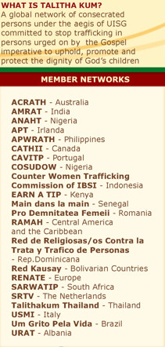
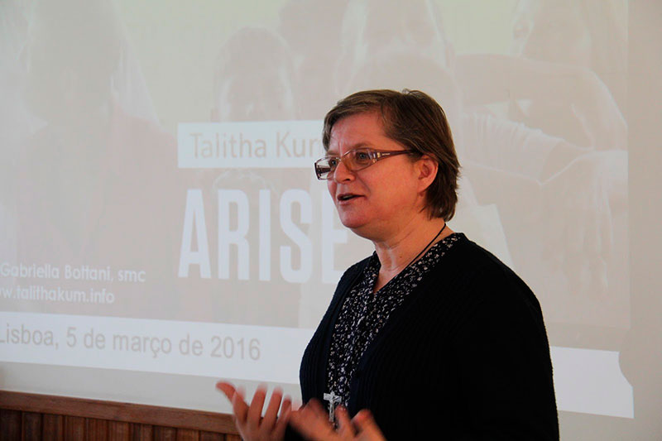
UISG: Talitha Kum:
President: Sr Gabriella Bottani CMS
Continental Network : Meetings every 3 months online

Slide 4
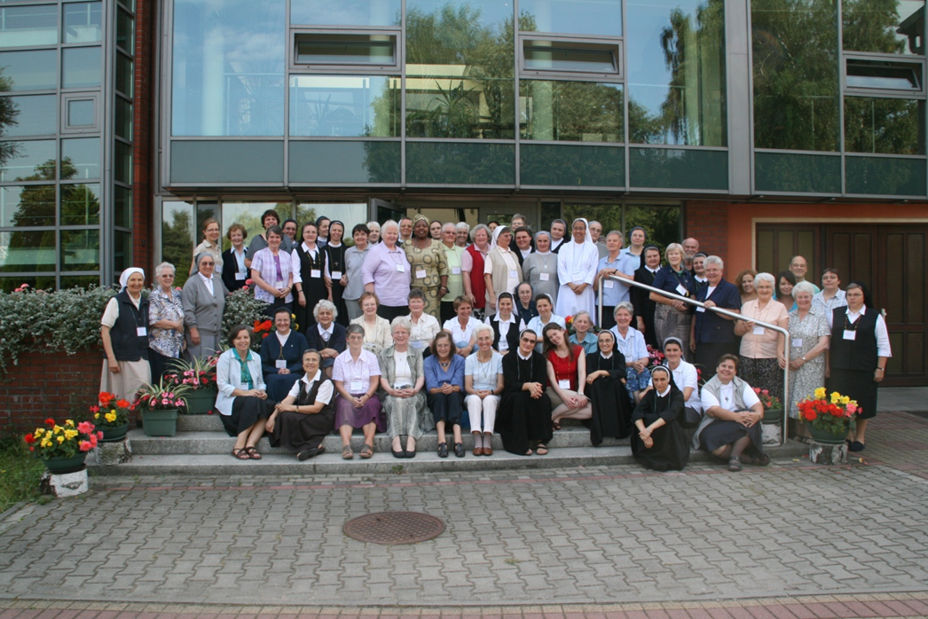
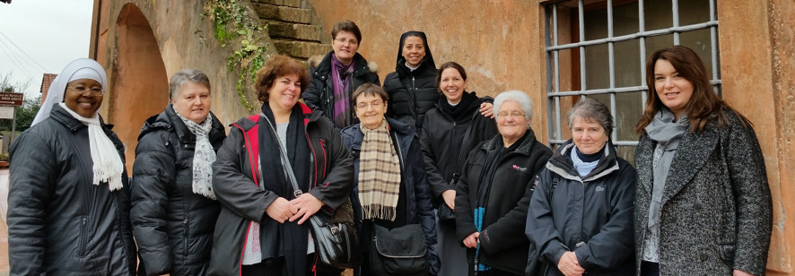
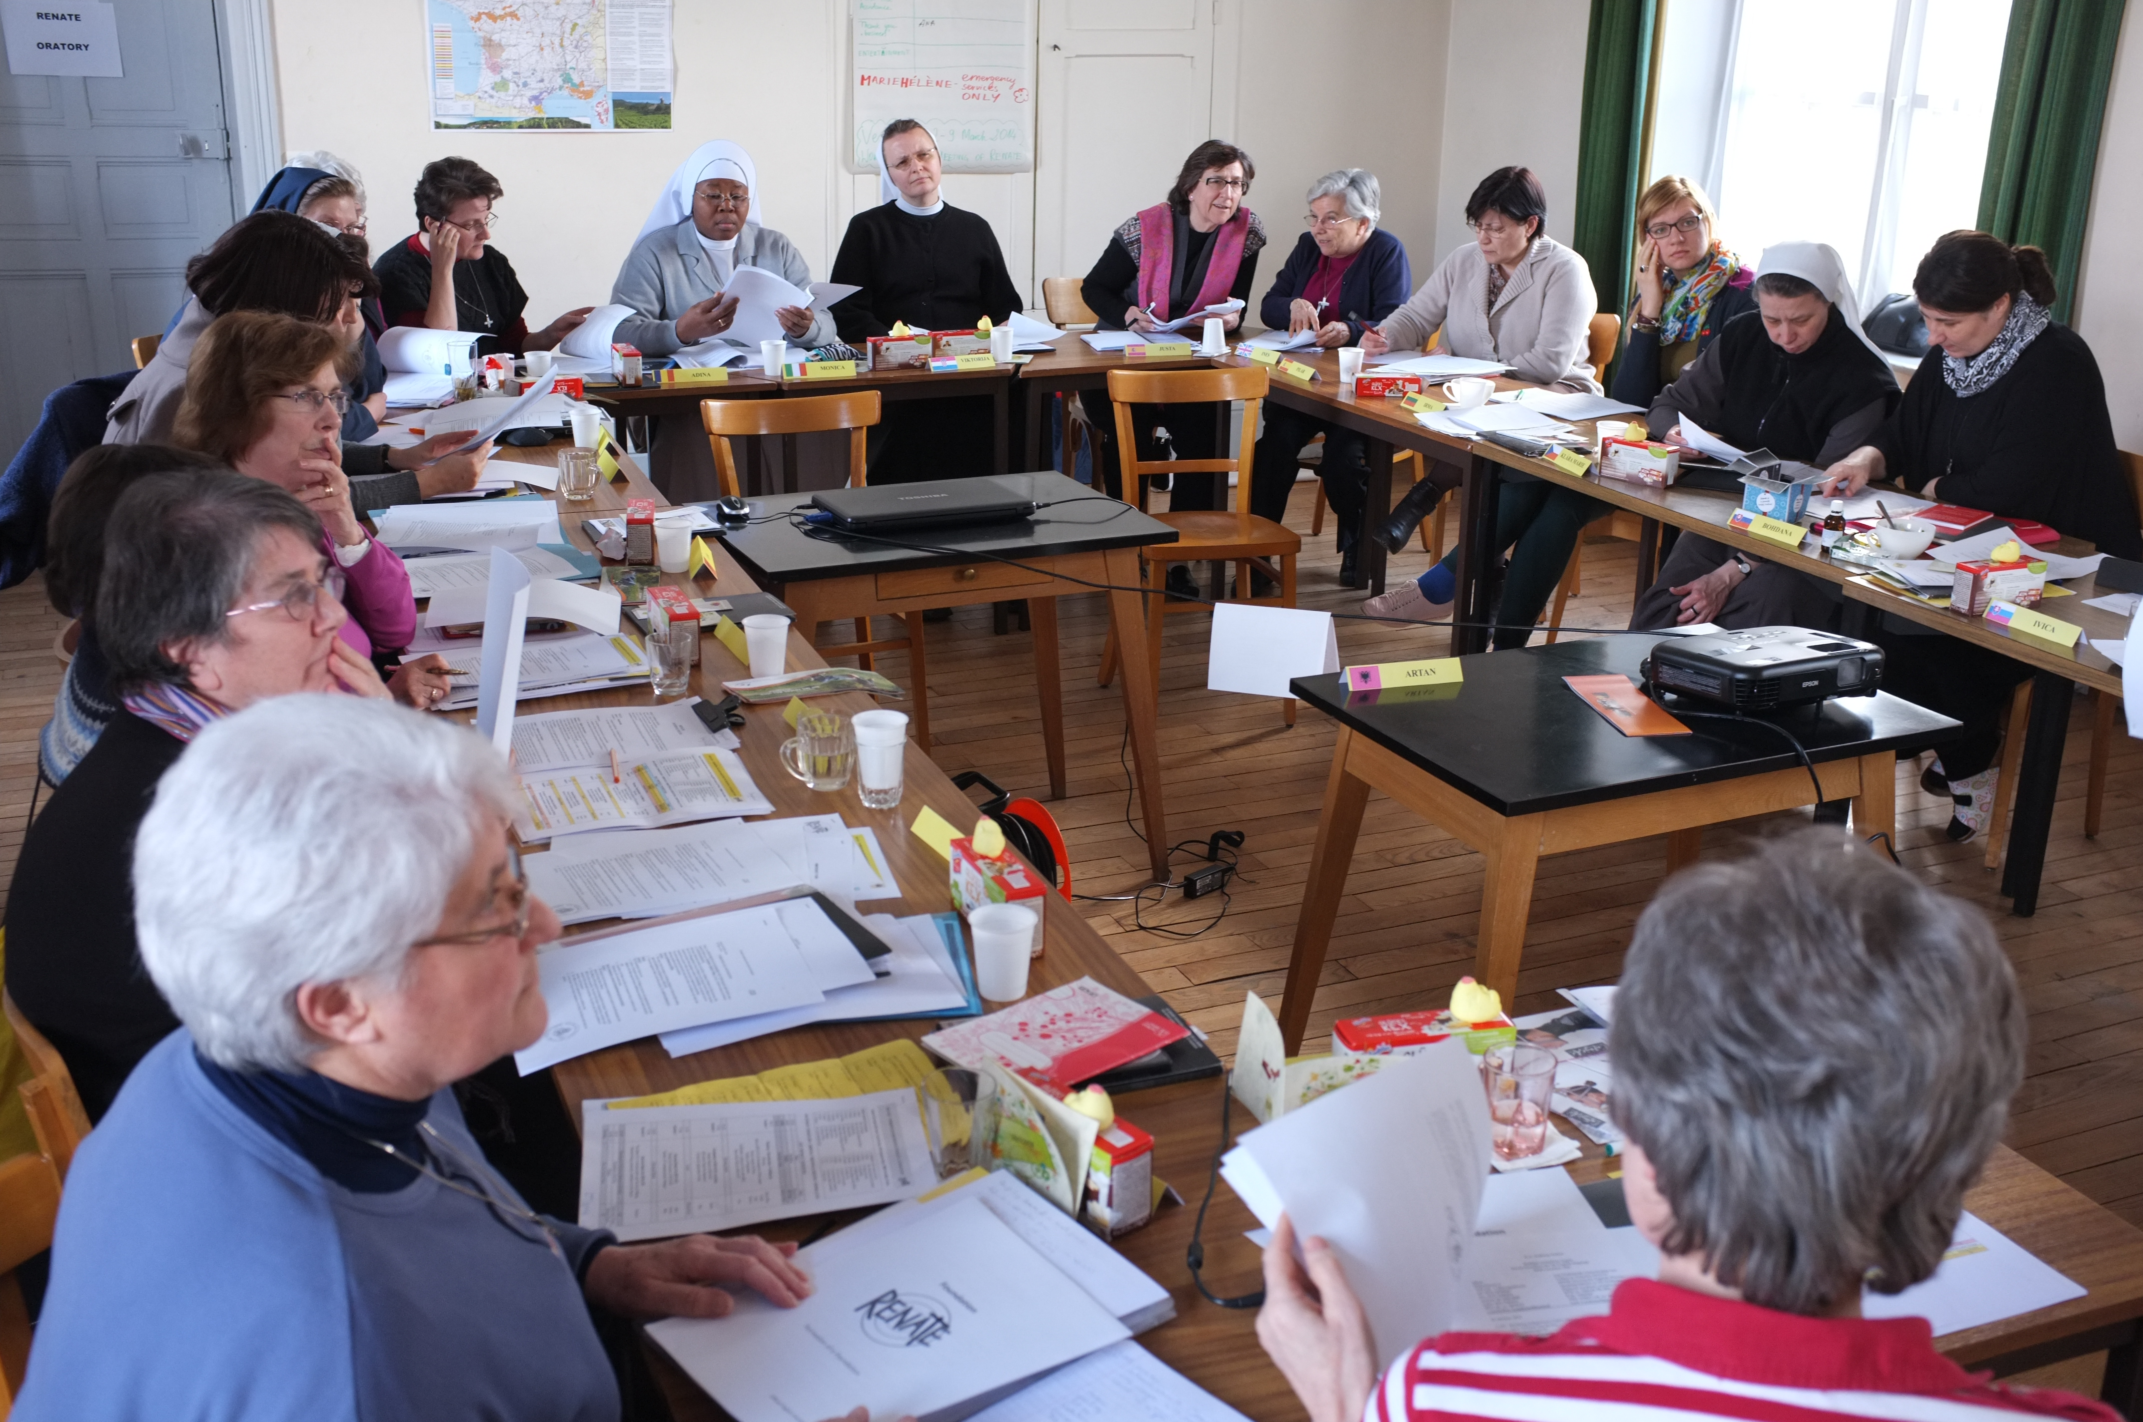
RENATE CORE GROUP
RENATE 1st ASSEMBLY: 2011
WHEN WE HEAR THE CRY…
TRZEBINIA, POLAND
TASK: Implementing the Mandate of the Assembly from Month to Month
Meetings every month on line, physical meeting twice a year
Working Board

Slide 5
Training Programmes: 2011 – 2017 300 + Participants
Social Teaching of the Church & Trafficking
Advocacy, Lobbying & Campaigning
Labour Trafficking
Web , Media and Marketing -
Trafficking related Issues
Rescue and Reintegration of Victims
Transformation for Change
Training on trauma
Training on migration

Slide 6
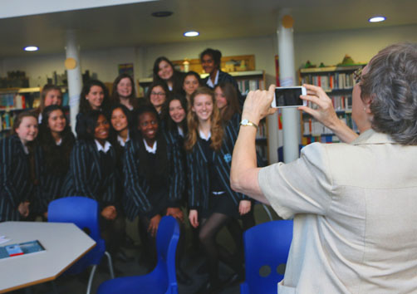
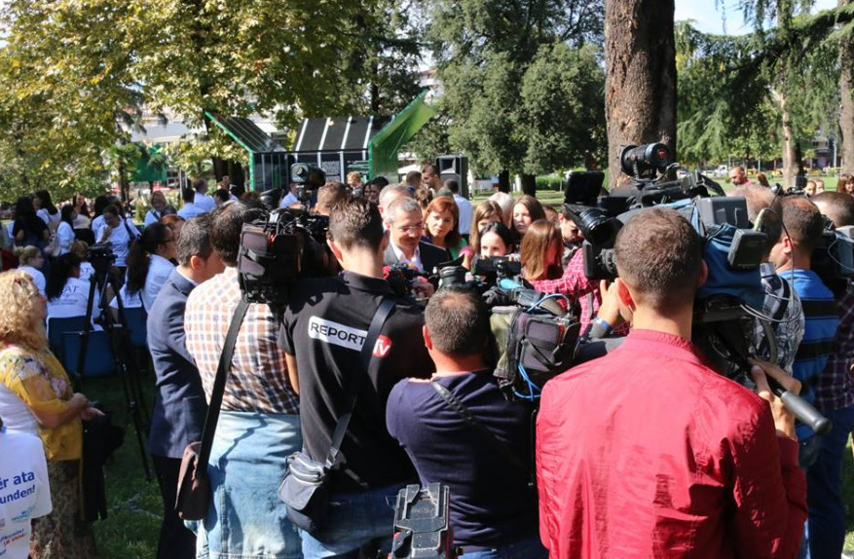
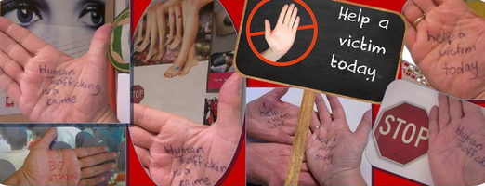
Campaign Against Trafficking
TenTen Drama Group UK
UNGift Box Campaign Albania
St Bakhita Day: Slovakia
RENATE Campaign on Line – EU day Against Trafficking

Slide 7
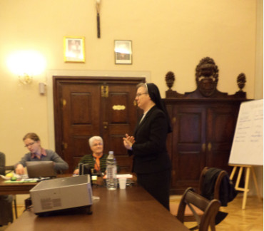
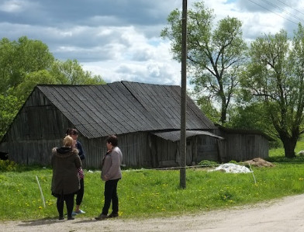
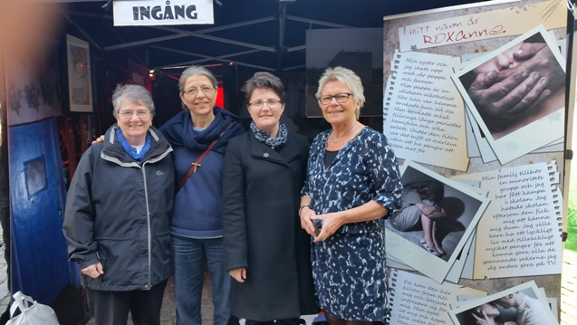
RENATE Working Cross Border
2011: Membership in15 European Countries – 8 in W. Europe 7 in E. Europe
2018: Membership in 29 European Countries – 202 MEMBERS
2018: Membership outside Europe in 4 Countries
Supporting a member in Croatia
Cross border work in Lithuania
Latest Member from Denmark

Slide 8
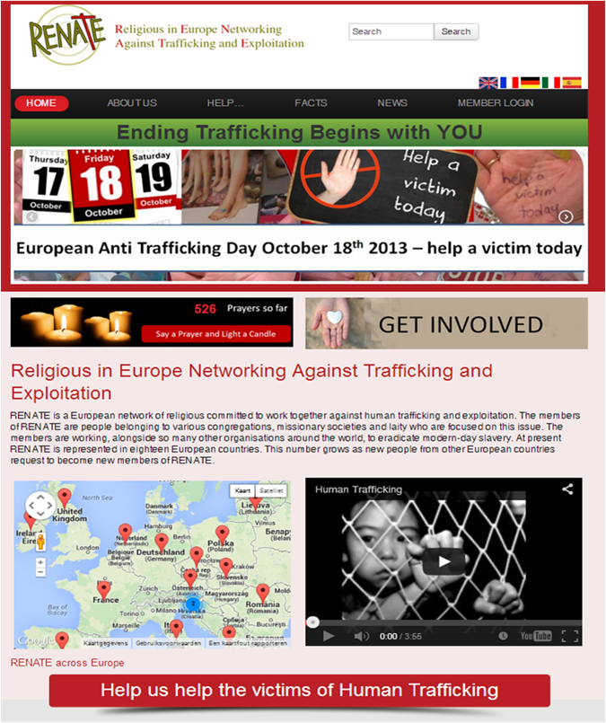
RENATE WEBSITE
COMMUNICATIONS

Slide 9
SR. ADINA BALAN, CJ

